Slide 1
Title: An Explainable AI Framework for Cricket Batsman Strength-Weakness Zone Detection and Multi-Option Bowling Strategy Recommendation
Shafin Ahmed
232-15-184
Department of CSE
Daffodil International University
Dr. S.M Aminul Haque
Professor and Associate Head
Department of CSE
Daffodil International University
Notes:
Good morning everyone. I am Shafin Ahmed, and today I am presenting my thesis title evaluation.
My proposed title is “An Explainable AI Framework for Cricket Batsman Strength-Weakness Zone Detection and Multi-Option Bowling Strategy Recommendation.”
The main idea of this research is to use explainable AI to understand a batsman’s strengths and weaknesses and then turn that analysis into practical bowling strategies.

Slide 2
Objective
Develop an XAI-based system for ball-by-ball batsman analysis.
Identify strong zones and weak zones automatically.
Analyze vulnerabilities across different match situations.
Generate some bowling strategy recommendations.
Use SHAP for transparent and explainable predictions.
Build a fully data-driven system that works for any batsman.
cont..

Slide 3
Motivation
Cricket is becoming increasingly data-driven.
Batsman analysis is still mostly manual and subjective.
Video-based analysis is time-consuming.
Different analysts may reach different conclusions.
cont..

Slide 4
Motivation
Existing AI tools often act as black boxes.
No single system combines analysis, explainability, and strategy.
This project provides an integrated XAI framework.
Supports analysts with faster, data-driven decisions.
Aims to improve bowling strategy and match outcomes.
cont..

Slide 5
Background Study
Rauf et al. [1] – Text mining for batting strength and weakness analysis.
Behera & Saradhi [2] – Rule-based player strength and weakness detection.
Chakwate & Madhan [3] – LSTM model using ball-by-ball data for match prediction.
Limitation: None combine explainability, complete player profiling, and bowling strategy in a single framework.
cont..

Slide 6
Background Study
Passi & Pandey [4] – ML models for player performance prediction.
Behera & Saradhi [5] – Large-scale batsman profiling using text commentary.
Shah & Shah [6] – Pressure index showing match situations affect player performance.
Saikia et al. [7] – ANN-based bowler performance prediction.
Limitation: Existing studies lack an integrated framework for explainable batsman profiling and bowling strategy generation.
cont..

Slide 7
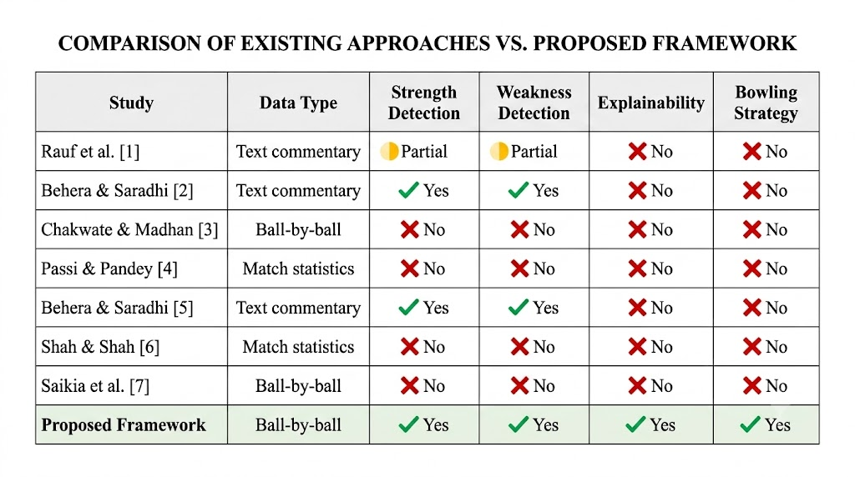
Background Study
cont..

Slide 8
Gap Analysis
Most studies rely on text or video data instead of structured ball-by-ball data.
Existing AI models lack explainability (XAI).
Current systems do not provide bowling strategy recommendations.
Most tools depend on pre-existing player databases.
Our framework addresses all these gaps in one integrated system.
cont..

Slide 9
Methodology
Data Collection, Data Analysis & Workflow
Data → Cricsheet + ESPNcricinfo
Clean → Missing values & duplicates
Features → Cricket-specific metrics
Train → RF, XGBoost, LightGBM
SHAP → Explain predictions
Recommend → Four bowling plans
Evaluate → Accuracy, Precision, Recall, F1, ROC-AUC
cont..

Slide 10
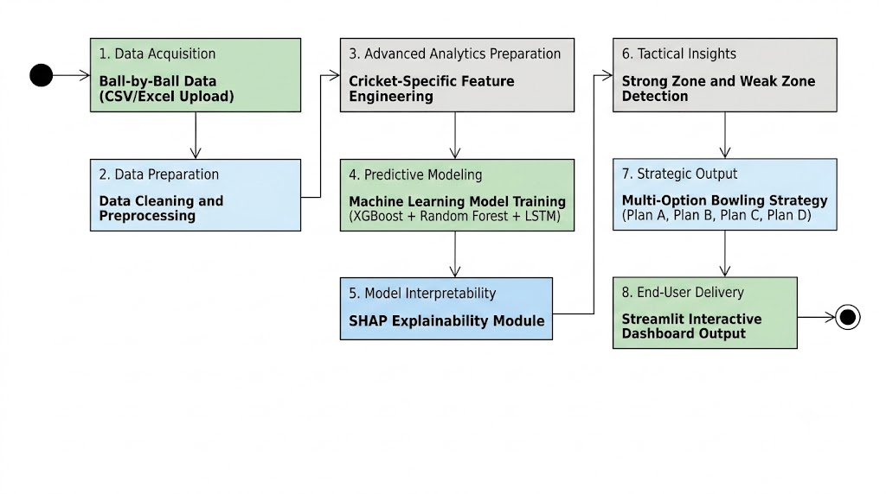
Methodology
Figure: Workflow Diagram of Cricket Bowling Strategy Analytics
cont..

Slide 11
Expected Outcomes
Trained ML model to identify batter's strong & weak zones from ball-by-ball data.
SHAP-based Explainable AI module with human-readable explanations.
Bowling strategy engine generating four alternative bowling plans.
Interactive Streamlit dashboard with heatmaps, zone maps, phase-wise analysis, SHAP charts, and strategy recommendations.
Research paper prepared for submission to an AI or sports analytics conference/journal.
cont..

Slide 12
Conclusion
Reduces manual and subjective batsman analysis through AI.
Automatically identifies strengths, weaknesses.
Provides four actionable bowling strategy recommendations.
Uses SHAP to ensure transparent and explainable decisions.
Fully data-driven and applicable from domestic to international cricket.
Establishes a foundation for future AI-powered cricket analytics research.
cont..

Slide 13
References
[1] Rauf, M. A., Ahmad, H., Faisal, C. M. N., Ahmad, S., & Habib, M. A. (2020). Extraction of strong and weak regions of cricket batsman through text-commentary analysis. 2020 IEEE 23rd International Multitopic Conference (INMIC), Bahawalpur, Pakistan, pp. 1–6. 🔗 https://ieeexplore.ieee.org/document/9318089/
[2] Behera, S. R., & Saradhi, V. V. (2021). Learning strength and weakness rules of cricket players. Proceedings of the ECML/PKDD 2021 Workshop on Machine Learning and Data Mining for Sports Analytics. 🔗 https://dtai.cs.kuleuven.be/events/MLSA21/papers/MLSA21_paper_behera.pdf
[3] Chakwate, R., & Madhan R, A. (2020). Analysing long short term memory models for cricket match outcome prediction. arXiv preprint arXiv:2011.02122. 🔗 https://arxiv.org/abs/2011.02122
[4] Passi, K., & Pandey, N. (2018). Increased prediction accuracy in the game of cricket using machine learning. arXiv preprint arXiv:1804.04226. 🔗 https://arxiv.org/abs/1804.04226
5] Behera, S. R., & Saradhi, V. V. (2023). Cricket player profiling: Unraveling strengths and weaknesses using text commentary data. arXiv preprint arXiv:2311.06818. 🔗 https://arxiv.org/abs/2311.06818
cont..

Slide 14
THANK YOU

